Slide 1

PASSWORD MANAGEMENT USING CRYPTOGRAPHY
Batch No: MLI - 22
Guided By :
-Rajesh Sir
Project members :
1.Md Abdus Samee
2.P Bharat Kumar
3.G Aravind

Slide 2
Slide Map
Abstract
Terminology
Existing system
Block diagram
Proposed system
system architecture
Project description
System Requirements
Advantages
Implementation
Results
www.techioanry.info

Slide 3
Abstract
Password managers protect users data by storing them securely and the user does not have to remember all of their passwords.
This project proposes a password manager which store passwords using cryptography technique. This project deals with RSA Encryption algorithm to encrypt passwords.
The project mainly protect the user credentials in a safe any secured manner.
We have used the the high bit key so that we can store the passwords in a way so that they can be prevented from any malicious attacks.
www.techioanry.info

Slide 4
Terminology Used
RSA - Rivest Shamir Adleman Algorithm.
PKCS1_OAEP- It is the RSA based algorithm using the OAEP (Optimal Asymmetric Encryption padding) to make more secured encyption.
www.techioanry.info

Slide 5
Existing System
The Existing Password managers use a less bit key and to store the public and private keys.
Several other encryption methods such as symmetric encryption and hashing technique use a single key for the encryption and decryption.
As if we use the asymmetric techniques than it has both the public and private key so that it is more secure,but the existing system does the encryption process using a less bit key.
The asymmetric encryption is the best way to store the data from potential hackers.
www.techioanry.info

Slide 6
Block Diagram
Data is encrypted using the RSA algorithm and converted to cipher text.
The cipher text data is stored in the database and accessed by user with the public key
Takes the Input
Output is seen in the form of the password
stored by the user.
The receiver will decrypt the data using the private key generated
A private key is generated at the receiver’s end
www.techioanry.info

Slide 7
Proposed System
In this we have used Asymmetric encryption to encrypt and decrypt the data by generating a public and private key.
The given password is encrypted using public key and stored in the database.
The ciphertext from the database is decrypted and the password is given out
The key changes after the database is accessed multiple times.
www.techioanry.info

Slide 8
System Architecture
Input data
Encrypt Data
Store ciphertext in Database
Key Change
Decrypt data
www.techioanry.info

Slide 9
Project Description
Our project Password Management using Cryptographic Techniques mainly deals with the storing of user credentials. Using different techniques we have developed our code so it connects to the database and stores the password.
The key point of our project is the high numbered bit key generated to store the cipher text which will change for a specific period of time to make it more secure.
The main role of using our project is to secure the user credentials by using a different techniques.
www.techioanry.info

Slide 10
System Requirements
Python 3
Oracle Database
Python libraries: Pycryptodome and cx_Oracle
www.techioanry.info

Slide 11
Advantages
The advantage of our project is it can secure the password by using the RSA algorithm and making the ciphe text unaccessible by generating a new private key for a specific period of time.
With our code we can easily connect to the database to store the data, to do it simply we have to give the global database name and the username and password to access the database.
The Password Manager generates new key and creates new ciphertexts for all the passwords that are stored after the database is accessed multiple times. This prevents the attackers from deciphering the ciphertext.
www.techioanry.info

Slide 12
Implementation
To Implement our project we have taken the help of the specific python modules that are to be used to do the encryption and decryption process.
We have also took the Oracle database 11g which is a remote database works on our computer to store the data generated by the algorithm.
We have implemented our code in such a way that it periodically changes the private key and generates a new key so that it remains secure.
www.techioanry.info

Slide 13
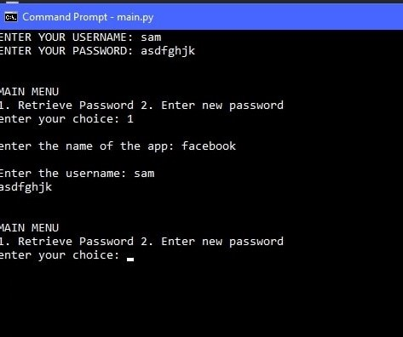
Results
After Implementing our code and connecting to the database it takes the details of the user credentials like the app,username and password for the specific app.
The main ouput of our project looks like this
www.techioanry.info

Slide 14
Conclusion
Our project is Password Manager which stores passwords using cryptographic techniques.
It uses RSA algorithm to encrypt the data and stores the ciphertext in the database. The key changes after the database is accessed multiple times.
The programing language we have used is Python. We chose python as it is an easy programming language with broad stand library for us to use from and it is also portable and interactive.
Our project is very efficient in managing passwords securely.
www.techioanry.info

Slide 15
References
RSA Encryption Implementation: https://pycryptodome.readthedocs.io/en/latest/
Oracle Database Connections: https://cx-oracle.readthedocs.io/en/latest/index.html
www.techioanry.info

